Slide 1
Lecture 2
Water is a Chemical!?

Slide 2
Water is the most important resource
Water is the most important resource. Without water life is not possible. From a chemical point of view, water, H2O, is a pure compound, but in reality, you seldom drink, see, touch or use pure water. Water from various sources contains dissolved gases, minerals, organic and inorganic substances. The rain curved an interesting landscape out of the lime stones in the area. Natural waters are often important parts of wonders of the world.

Slide 3
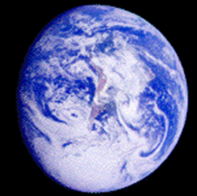
The hydrosphere
The total water system surrounding the planet Earth is called the hydrosphere. It includes freshwater systems, oceans, atmosphere vapour, and biological waters. The Arctic, Atlantic, Indian, and Pacific oceans cover 71% of the Earth surface, and contain 97% of all water. Less than 1% is fresh water, and 2-3 % is ice caps and glaciers. The Antarctic Ice Sheet is almost the size of North America continent. These waters dominate our weather and climate, directly and indirectly affecting our daily lives. They cover 3.35x108 km2. The four oceans have a total volume of 1.35x109 km

Slide 4

The hydrosphere
The sunlight dims by 1/10 for every 75 m in the ocean, and humans barely see light below 500 m. The temperature of almost all of the deep ocean is 4°C (277 K).
The average ocean depth is 4 km, and the deepest point at the Mariana Trench is 10,912 m (35,802 ft), which compares to the height of 8.8 km for Mount Everest.
Among the planets, Earth is the only one in which there are solid, liquid and gaseous waters. These conditions are just right for life, for which water is a vital part. Water is the most abundant substance in the biosphere of Earth.

Slide 5
Forms of water
Water is the most abundant compound on Earth's surface, covering 70 percent of the planet. In nature, water exists in liquid, solid, and gaseous states. It is in dynamic equilibrium between the liquid and gas states at standard temperature and pressure. At room temperature, it is a tasteless and odorless liquid, nearly colorless with a hint of blue. Many substances dissolve in water and it is commonly referred to as the universal solvent. Because of this, water in nature and in use is rarely pure and some properties may vary from those of the pure substance. However, there are also many compounds that are essentially, if not completely, insoluble in water. Water is the only common substance found naturally in all three common states of matter and it is essential for all life on Earth.[8] Water makes up 55% to 78% of the human body.[9]

Slide 6
Forms of water
Like many substances, water can take numerous forms that are broadly categorized by phase of matter.
The liquid phase is the most common among water's phases (within the Earth's atmosphere and surface) and is the form that is generally denoted by the word "water."
The solid phase of water is known as ice and commonly takes the structure of hard, amalgamated crystals, such as ice cubes, or loosely accumulated granular crystals, like snow.
The gaseous phase of water is known as water vapor (or steam), and is characterized by water assuming the configuration of a transparent cloud.
The fourth state of water, that of a supercritical fluid, is much less common than the other three and only rarely occurs in nature, in extremely uninhabitable conditions. When water achieves a specific critical temperature and a specific critical pressure (647 K and 22.064 MPa), liquid and gas phase merge to one homogeneous fluid phase, with properties of both gas and liquid. One example of naturally occurring supercritical water is found in the hottest parts of deep water hydrothermal vents, in which water is heated to the critical temperature by scalding volcanic plumes and achieves the critical pressure because of the crushing weight of the ocean at the extreme depths at which the vents are located. Additionally, anywhere there is volcanic activity below a depth of 2.25 km (1.40 mi) can be expected to have water in the supercritical phase.

Slide 7
Heavy water and Light water
Heavy water is water with a higher-than-average deuterium content, up to 100%. Chemically, it is similar but not identical to normal water. This is because the nucleus of deuterium is twice as heavy as protium, and this causes noticeable differences in bonding energies. Because water molecules exchange hydrogen atoms with one another, hydrogen deuterium oxide (DOH) is much more common in low-purity heavy water than pure dideuterium monoxide (D2O). Humans are generally unaware of taste differences, but sometimes report a burning sensation or sweet flavor. Rats, however, are able to avoid heavy water by smell. Toxic to many animals,[16] heavy water is used in the nuclear reactor industry to moderate (slow down) neutrons.
Light water more specifically refers to deuterium-depleted water (DDW), water in which the deuterium content has been reduced below the standard 155 ppm level.

Slide 9
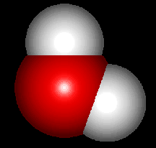
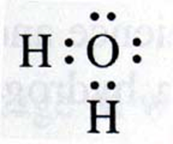
Water is a Chemical!?
Indeed! Water is one of our most plentiful chemicals. Its chemical formula, H20, is probably the most well known of all chemical formulas.
What does the chemical formula tell us?
The formula H20 tells us that one molecule of water is comprised of 2 atoms of hydrogen and one atom of oxygen bonded together. The bonds which hold the hydrogen and oxygen together are called covalent bonds - they are very strong.
The 'sticks' holding the hydrogens to the oxygen represent covalent bonds.

Slide 10
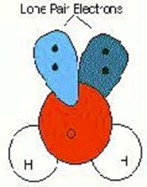
Lone Pair Electrons
Lone Pair Electrons- these are the electrons that are not involved in the covalent bonds. The pairs of electrons are left alone. In our picture they are represented by the double dots. These lone pairs are very negative - containing two negative electrons each - and want to stay away from each other as much as possible. These repulsive forces act to push the hydrogens closer together

Slide 11
Why does the water molecule look bent?
The water molecule maintains a bent shape (bent at 107.5 degrees actually) because of two considerations. First the tetrahedral arrangement around the oxygen and Second the presence of lone pair electrons on the oxygen.

Slide 12
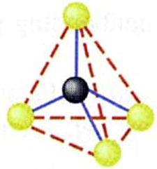
Tetrahedral arrangement
Tetrahedral means "four-sided". In chemistry we interpret this in our imaginations. Draw the central atom in an imaginary space. Next put the atoms attached to the central atom around it such that the distance between them is maximized. The arrangement you'll adopt will be the form of a regular tetrahedron. This molecular shape is shown below. It has regular bond angles of 104.5

Slide 13
The shape and structure of a water molecule
Like many things in the chemical world, the shape and structure of a molecule is an important determinant of its function. The importance of the bent structure of water is that it provides water with two distinct "sides": One side of the water molecule has two negative lone pairs, while the other side presents the two hydrogens. Let's take another look.
But it's not just that the molecule is bent that makes it special. Water is also highly polar - the two sides of water have very different charge

Slide 14
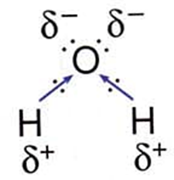
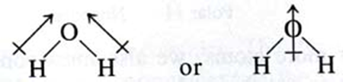
The shape and structure of a water molecule
The hydrogens are slightly positive. They get this way because of the "electronegativity" of oxygen. Electronegativity is a measure of how much one atom wants to have electrons, and oxygen wants to have electrons more than hydrogen does. Oxygen has a higher electronegativity. Because of this difference in electronegativity, the electrons in the covalent bonds between oxygen and hydrogen get pulled slightly toward the oxygen. This leaves the hydrogens a little bit electron-deficient and thus slightly positive. We can draw this polarization like this:
Or looking at it from a "net polarization" perspective, like this:

Slide 15
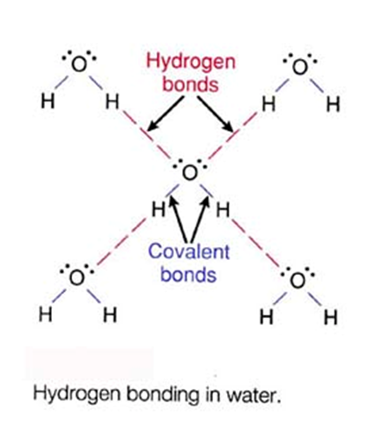
Polarization and properties of water
Because water has a slightly negative end and a slightly positive end, it can interact with itself and form a highly organized 'inter-molecular' network. The positive hydrogen end of one molecule can interact favorably with the negative lone pair of another water molecule. This interaction is call "Hydrogen Bonding". It is a type of weak electrostatic attraction (positive to negative). Because each and every one of the water molecules can form four Hydrogen Bonds, an elaborate network of molecules is formed.

Slide 16
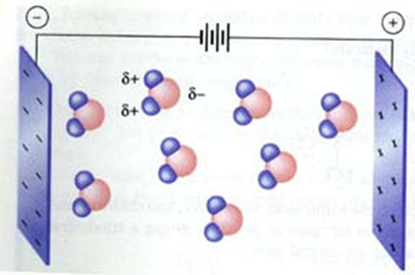
Hydrogen Bonds
But if the Hydrogen Bonds are weak, how can they be important?
Think of how many there are! There is strength in numbers!
The polarity also allows water interact with an electric field

Slide 17
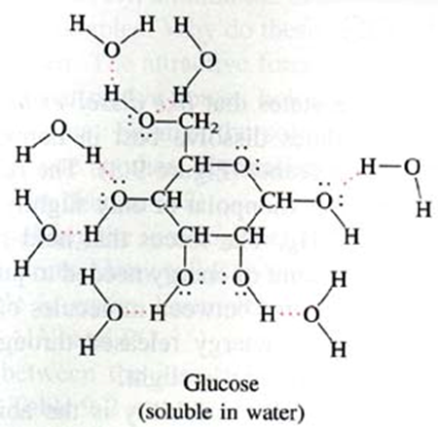
Hydrogen Bonds
And to interact with other polar molecules - which is how substances become dissolved in water

Slide 18
Hydrogeochemical methods of searches
Lecture 3
The anomalous properties of water

Slide 19
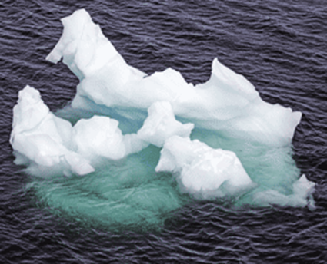
The range of anomalous properties of water
The anomalous properties of water are those where the behavior- поведение of liquid water is quite different from what is found with other liquids. No other material is commonly - часто found as solid, liquid and gas. Frozen water (ice) also shows anomalies when compared with в сравнении с other solids. Although it is simple molecule (H2O), it has a highly complex - сложную структуру and anomalous character due to - зависящие its intra-molecular hydrogen bonding.

Slide 20
The range - диапазон of anomalous properties of water
As a gas, water is one of lightest known, as a liquid it is much denser плотнее than expected – ожидается and as a solid it is much lighter than expected when compared with its liquid form.
It can be extremely slippery – скользким and extremely sticky – липким at the same time. Many other anomalies of water may remain to be discovered, such as the possible link of water to room temperature superconductivity.

Slide 21
The range of anomalous properties of water
As liquid water is so common-place - повсеместно in our everyday lives, it is often regarded as a ‘typical’ liquid.
In reality, water is most atypical as a liquid, behaving – ведущая себя as a quite different material at low temperatures to that when it is hot.
It has often been stated that life depends on these anomalous properties of water

Slide 22
The range of anomalous properties of water
In particular, the high cohesion between molecules gives it a high freezing and melting point, such that we and our planet are bathed in liquid water. The large heat capacity – теплоемкость , high thermal conductivity and high water content in organisms contribute позволяют to thermal regulation and prevent – предотвращают local temperature fluctuations – перепады , thus allowing позволяет us to more easily control our body temperature. The high latent скрытая heat of evaporation gives resistance устойчивость to dehydration and considerable значительного evaporative cooling.
загар

Slide 23
The range of anomalous properties of water
It has unique уникальные hydration properties towards по отношению important biological macromolecules (proteins and nucleic acids) that determine определяет their three-dimensional structures, and hence как следствие their biological functions, in solution. This hydration forms gels that can reversibly undergo преобразовываться the gel-sol phase transitions that underlie лежать в основе many cellular клеточные mechanisms.
белок

Slide 24
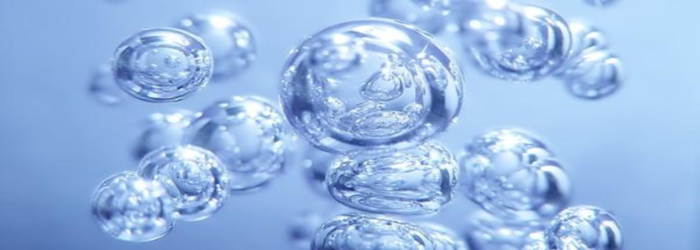
The range of anomalous properties of water
Water ionizes and allows позволяет easy proton exchange between molecules, so contributing обеспечивая to the richness of the ionic interactions in biology.
Also, it is an excellent solvent due to под влиянием its polarity, high relative диэлектрической проницаемостью permittivity (dielectric constant) and small size, particularly for polar and ionic compounds соединений and salts.

Slide 25
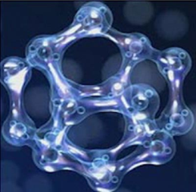
The range of anomalous properties of water
At 4 °C water expands on heating or cooling. This density maximum together with the low ice density results in (i) the necessity that all of a body of fresh water (not just its surface) is close to 4 °C before any freezing can occur, (ii) the freezing of rivers, lakes and oceans is from the top down, so permitting survival ПОЗВОЛЯЕТ ВЫЖИВАТЬ of the bottom ecology, insulating изолируя the water from further freezing, reflecting back sunlight into space and allowing позволяет rapid thawing таять, and (iii) density driven приводит thermal convection causing в результате чего seasonal mixing in deeper temperate умеренных waters carrying life-providing oxygen into the depths.

Slide 26
The range of anomalous properties of water
The large heat capacity теплоемкость of the oceans and seas allows позволяет them to act as heat reservoirs such that sea temperatures vary изменяются only a third as much as land temperatures and so moderate our planet's climate (for example, the Gulf stream carries tropical warmth to northwestern Europe).
The compressibility сжимаемость of water reduces уменьшает the sea level by about 40 m giving us 5% more land. Water's high surface tension поверхностное натяжение plus its expansion расширение on freezing encourages приводит the erosion of rocks to give soil for our agriculture.

Slide 27
The range of anomalous properties of water
Notable известными amongst the anomalies of water are the opposite properties of hot and cold water, with the anomalous behavior поведением more accentuated присущим at low temperatures where the properties of supercooled water often diverge исходят from those of hexagonal ice.
As (supercooled) cold liquid water is heated нагревает individual molecules shrink усадки , bulk объем water shrinks and becomes less easy to compress – сжать, its refractive index показатель преломления increases, the speed of sound within внутри it increases, gases become less soluble растворимыми and it is easier to heat and conducts heat better.

Slide 28
The range of anomalous properties of water
In contrast as hot liquid water is heated it expands расширяется, it becomes easier to compress, its refractive index reduces – уменьшается показатель преломления, the speed of sound within it decreases меньше , gases become more soluble and it is harder to heat труднее нагреть and a poorer conductor of heat.
With increasing pressure, individual molecules expand расширяются, cold water molecules move faster but hot water molecules move slower. Hot water freezes faster than cold water and ice melts when compressed except за исключением at high pressures when liquid water freezes when compressed.

Slide 29
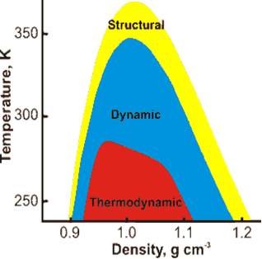
The range of anomalous properties of water
The anomalies of water appear показаны as a hierarchy иерархии of effects with different bounds - пределами. These are shown indicatively opposite as derived from modeling, not experimental data.
The ‘Structural’ bounds indicate показывает where water is more disordered неупорядочена when compressed при сжатии, the ‘Dynamic’ bounds indicate where diffusion increases with density, and the ‘Thermodynamic’ bounds show where there is a temperature of maximum density. As density always increases with increasing pressure, a similar relationship holds with pressure along the horizontal axis.

Slide 30
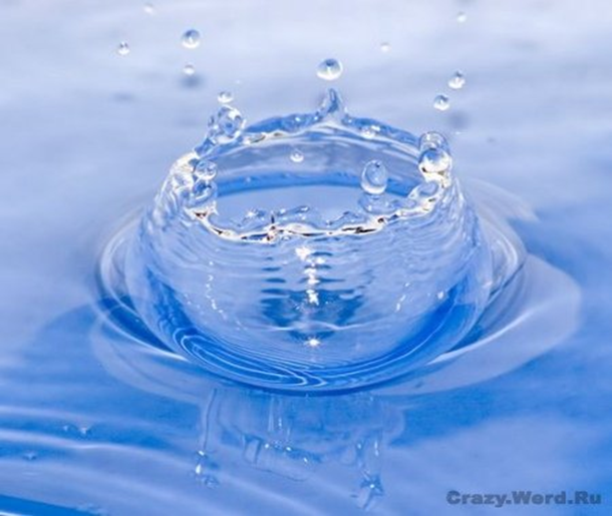
The range of anomalous properties of water
Water phase anomalies
Water density- плотность anomalies
Water material anomalies
Water thermodynamic anomalies
Water physical anomalies

Slide 31
Water phase anomalies
1. Water has unusually high melting point.
2. Water has unusually high boiling point.
3. Water has unusually high critical point.
4. Solid water exists in a wider variety of stable (and metastable) crystal and amorphous structures than other materials.
5. The thermal conductivity, shear modulus and transverse sound velocity of ice reduce with increasing pressure.
6. The structure of liquid water changes at high pressure.
7. Supercooled water has two phases and a second critical point at about -91 °C.
8. Liquid water is easily supercooled but glassified with difficulty.
9. Liquid water exists at very low temperatures and freezes on heating.
10. Liquid water may be easily superheated
11. Hot water may freeze faster than cold water; the Mpemba effect.
12. Warm water vibrates longer than cold water.
13. Water molecules shrink as the temperature rises and expand as the pressure increases

Slide 32
Water density anomalies
The density of ice increases on heating (up to 70 K).
Water shrinks on melting.
Pressure reduces ice's melting point
Liquid water has a high density that increases on heating (up to 3.984 °C).
The surface of water is denser than the bulk
Pressure reduces the temperature of maximum density.
There is a minimum in the density of supercooled water
Water has a low coefficient of expansion (thermal expansivity).
Water's thermal expansivity reduces increasingly (becoming negative) at low temperatures.
Water's thermal expansivity increases with increased pressure
The number of nearest neighbors increases on melting.
The number of nearest neighbors increases with temperature

Slide 33
13. Water has unusually low compressibility
14. The compressibility drops as temperature increases up to 46.5 °C.
15. There is a maximum in the compressibility-temperature relationship.
16. The speed of sound increases with temperature up to 74 °C.
17. The speed of sound may show a minimum.
18. 'Fast sound' is found at high frequencies and shows an discontinuity at higher pressure.
19. NMR spin-lattice relaxation time is very small at low temperatures
20. The NMR shift increases to a maximum at low (supercool) temperatures
21. The refractive index of water has a maximum value at just below 0 °C.
22. The change in volume as liquid changes to gas is very large

Slide 34
Water material anomalies
No aqueous solution is ideal.
D₂O and T₂O differ significantly from H₂O in their physical properties.
Liquid H₂O and D₂O differ significantly in their phase behavior
H₂O and D ₂O ices differ significantly in their quantum behavior
The mean kinetic energy of water's hydrogen atoms increases at low temperature.
Solutes have varying effects on properties such as density and viscosity.
The solubilities of non-polar gases in water decrease with temperature to a minimum and then rise.
The dielectric constant of waterand ice are high
The relative permittivity shows a temperature maximum
Proton and hydroxide ion mobilities are anomalously fast in an electric field.
The electrical conductivity of water rises to a maximum at about 230 °C
The electrical conductivity of water rises considerably with frequency.
Acidity constants of weak acids show temperature minima.
X-ray diffraction shows an unusually detailed structure.
Under high pressure water molecules move further away from each other with increasing pressure; a density-distance paradox
Water adsorption may cause negative electrical resistance

Slide 35
Water thermodynamicanomalies
1. The heat of fusion of water with temperature exhibits a maximum at -17 °C.
2. Water has over twice the specific heat capacity of ice or steam
3. The specific heat capacity (CP and CV) is unusually high
4. The specific heat capacity CP has a minimum at 36 °C
5. The specific heat capacity (CP) has a maximum at about -45 °C.
6. The specific heat capacity (CP) has a minimum with respect to pressure
7. The heat capacity (CV) has a maximum.
8. High heat of vaporization.
9. High heat of sublimation.
10. High entropy of vaporization.
11. The thermal conductivity of water is high and rises to a maximum at about 130 °C

Slide 36
Water physical anomalies
1. Water has unusually high viscosity.
2. Large viscosity and Prandtl number increase as the temperature is lowered.
3. Water's viscosity decreases with pressure below 33 °C.
4. Large diffusion decrease as the temperature is lowered.
5. At low temperatures, the self-diffusion of water increases as the density and pressure increase.
6. The thermal diffusivity rises to a maximum at about 0.8 GPa.
7. Water has unusually high surface tension.
8. Some salts give a surface tension-concentration minimum; the Jones-Ray effect.
9. Some salts prevent the coalescence of small bubbles.
10. The molar ionic volumes of salts show maxima with respect to temperature

Slide 37
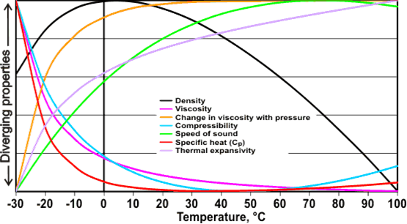
The figure left shows some of the anomalous properties of liquid water that are related to temperature. The graph uses data that have been scaled between their maximum and minimum values within this range

